Slide 1

Department of Computer Science and Engineering
B.Tech. Third Year - Design Project - II
Stock market price prediction using machine learning
COORDINATOR:
Dr. Antonidoss A
TEAM MEMBERS:
TITUS YESUDAS 19113162
SAI PRANEETH 19113169
PADALA JOSEPH 19113176

Slide 2
Agenda
ABSTRACT
INTRODUCTION
REQUIREMENTS
LITERATURE SURVEY
BASE PAPER
ARCHITECTURE DIAGRAM
USECASE DIAGRAM
ER DIAGRAM
MODULES
ALGORITHM
REFERENCES

Slide 3
ABSTRACT
This project’s objective is to improve the quality of output of stock market predicted by using stock value.
A number of researchers have come up with various ways to solve this problem, mainly there are traditional methods so far, such as artificial neural network is a way to get hidden patterns and classify the data which is used in predicting stock market.
This project proposes a different method for prognosing stock market prices.

Slide 4
INTRODUCTION
A stock market is a public market where you can buy and sell shares for publicly listed companies. The stocks, also known as equities, represent ownership in the company.
Stock Price Prediction using machine learning helps you discover the future value of company stock and other financial assets traded on an exchange.
The entire idea of predicting stock prices is to gain significant profits. Predicting how the stock market will perform is a hard task to do.

Slide 5
REQUIREMENTS
Python 3.10
Numpy
Pandas
MATPLOTLIB
STATSMODELS.TSA for ARIMA
SKLEARN MATRIX

Slide 6
Thank you
LITERATURE SURVEY
TITLE | AUTHOR | Methodology used | Proposed system
Stock price forecasting using data from yahoo finance | Jai jagwani, Hardik Sachdeva,manav gupta Publication year: 2018 | Relationship between different exisiting time series algorithm. | The prediction model,which based on SVM and independent analysis
Stock market prediction using machine learning | Ishitha Parmar, Lokesh chouhan Publication year: 2017 | Regression and LSTM based machine learning to forecast stock prices | The stock market values examine the Microsoft corporation (MSFT)
Multi-category events driven stock price trends prediction | Youxun lei , kaiyue zhou Publication year:2018 | Drive the desire to predict the movements and reap profits there . | The process of LSTM model and using adam optimizer.

Slide 7
Title | AUTHOR | METHODOLOGY USED | PROPOSED SYSTEM
Share price prediction using machine learning technique | Vivekananda j.g Naveen nethra reddy j, S.Prince Mary Dr.B.Bharathi 2018 | developed this using all latest technologies to make it more easy andcustomizable to users. Cloud for storing the data | The Automated system with distributed architecture can support issues The decision process in more faster and more consistent.
Share price trend prediction using CRNN and LSTM | Shao-en-gao, bo- sheng lin Publication : 2017 | The artificial recurrent neural networks . | The Automated system with distributed architecture can support issues like. The system maintains the different location that are available and registered in a central DB,
Stocks predictions using hybrid machine learning | Vibha lahane, Rahul Publication: 2019 | The purpose of a deep learning approach utilizing Long short term approach | The prediction model,which based on SVM and independent analysis

Slide 8
Stock market prediction and analysis | John-yonus | The process of using the fundamental analysis | The Automated system with distributed architecture can support issues The decision process in more faster and more consistent.
Systematic analysis and stock market prediction | Dattatray p gandmahal Publication: 2014 | Regression and LSTM based machine learning to forecast stock prices | The prediction model,which based on SVM and independent analysis

Slide 9
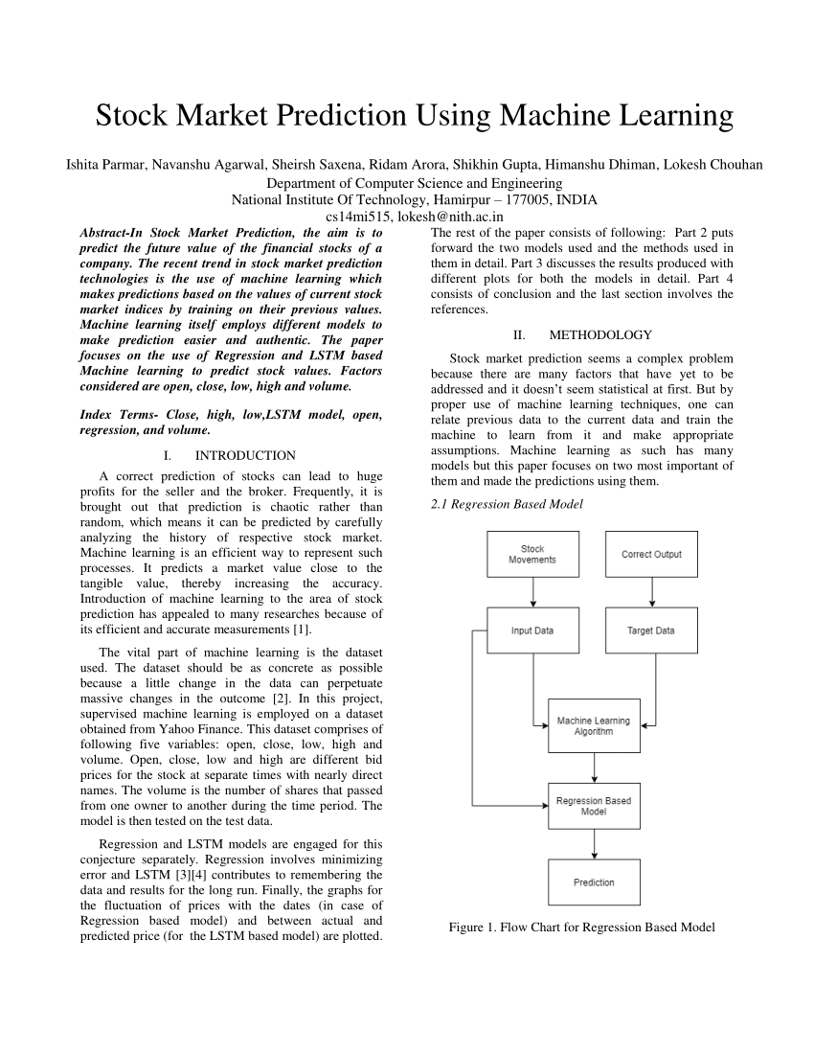
BASE PAPER
https://www.researchgate.net/publication/261991913_Online_computerized_Hotel_Management_System

Slide 10
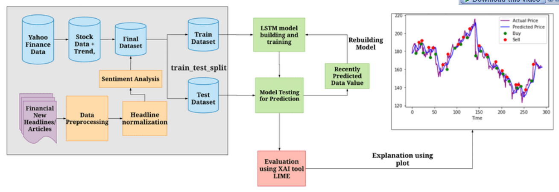
ARCHITECTURE DIAGRAM

Slide 11
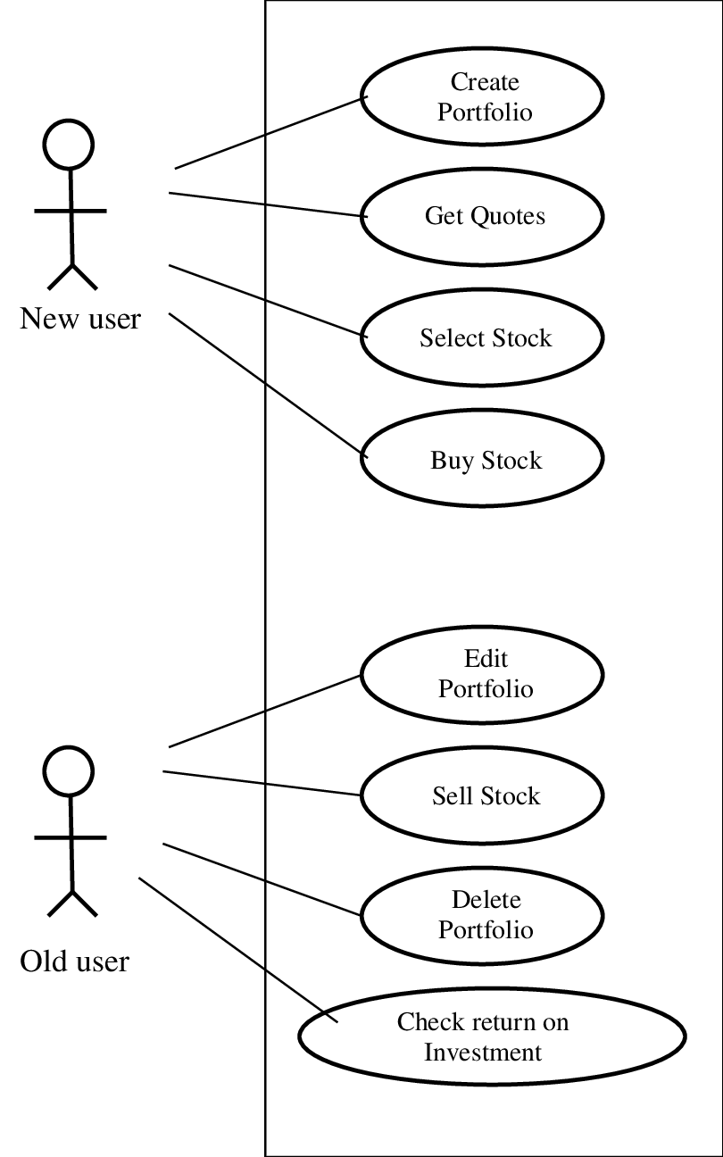
USE CASE DIAGRAM

Slide 12
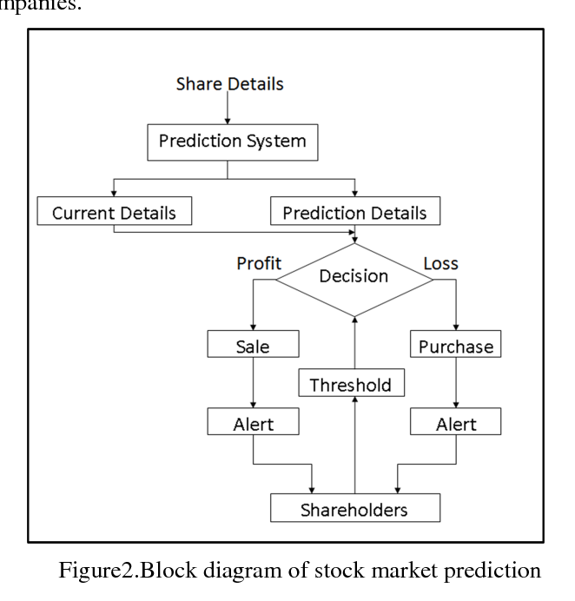
ER DIAGRAM

Slide 13
MODULES
Time series analysis
Data collection
Pre processing
Training the machine
Data scoring

Slide 14
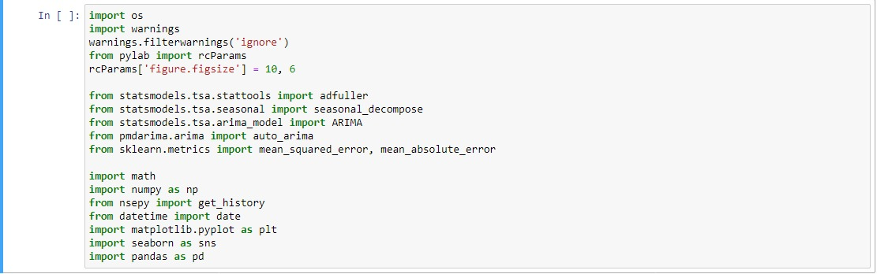
Program

Slide 15
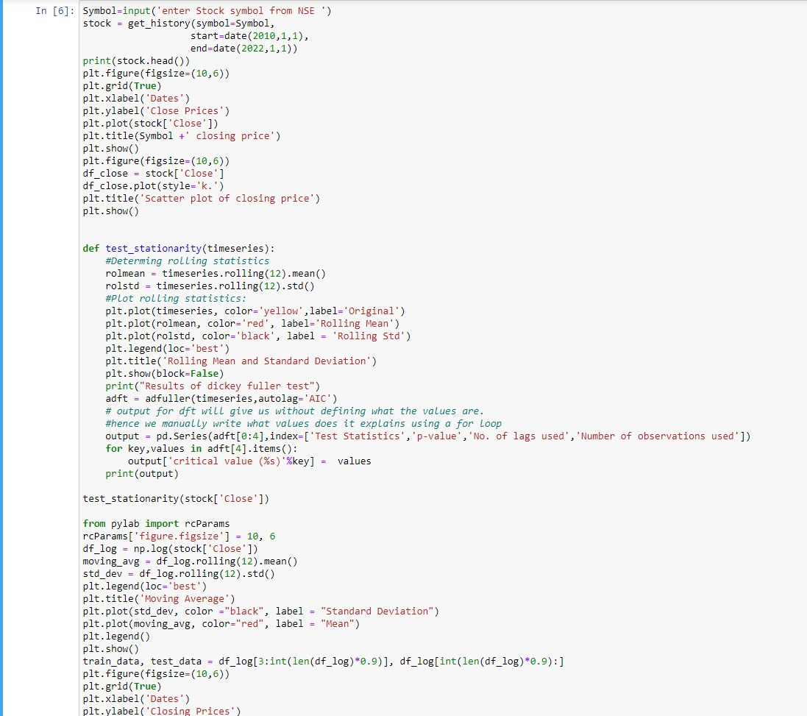

Slide 16
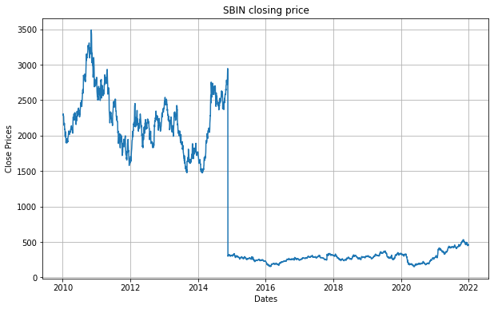
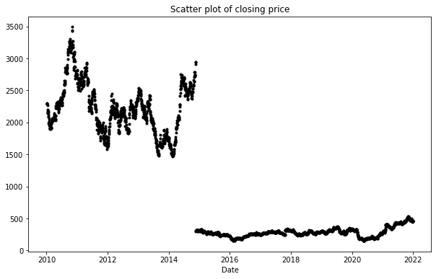
OUTPUT SCREENSHOT

Slide 17
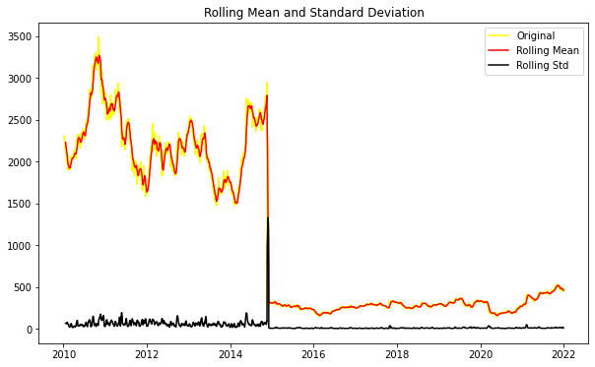
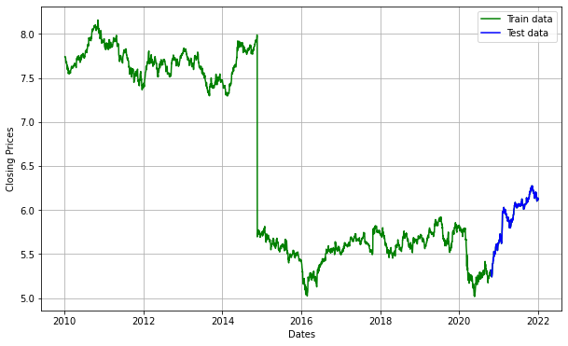
OUTPUT SCREENSHOTS

Slide 18
REFRENCES
“Basic LSTM Unit Transfer Function Diagram from [10] | Download Scientific Diagram.” https://www.researchgate.net/figure/Basic-LSTM-Unit-Transfer-Function- Diagram-from-10_fig8_308804546 (accessed Jun. 03, 2020).
“Fig. 1: An example of CNN architecture.,” ResearchGate. https://www.researchgate.net/figure/An-example-of-CNN-architecture_fig1_320748406 (accessed Jun. 03, 2020).
Y. Kim, “Convolutional Neural Networks for Sentence Classification,” in Proceedings of the 2014 Conference on Empirical Methods in Natural Language Processing (EMNLP), Doha, Qatar, Oct. 2014, pp. 1746–1751, doi: 10.3115/v1/D14-1181.

Slide 19
THANK YOU

